Slide 1

Unit 14

Slide 2

Unit 14
I remember meeting
all of you in Grade 7.

Slide 3



Slide 4


1. To learn the content and structure of a
graduation speech.
2. To learn to use some words and
expressions:
gentleman congratulate thirsty
thankful task ahead separate wing
first of all be thirsty for ahead of
along with be thankful to sb. set out
be responsible for separate from

Slide 5


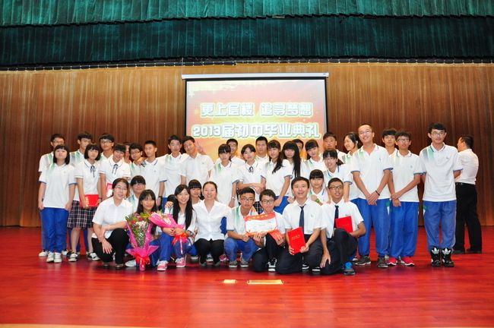
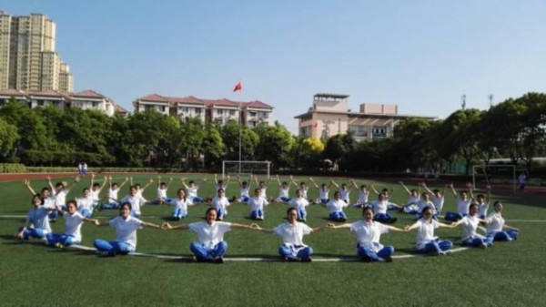
What will you do when you graduate?
take a graduation picture
hold a graduation ceremony

Slide 6
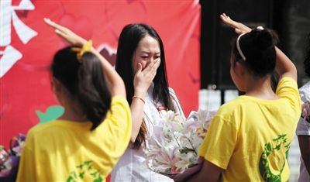
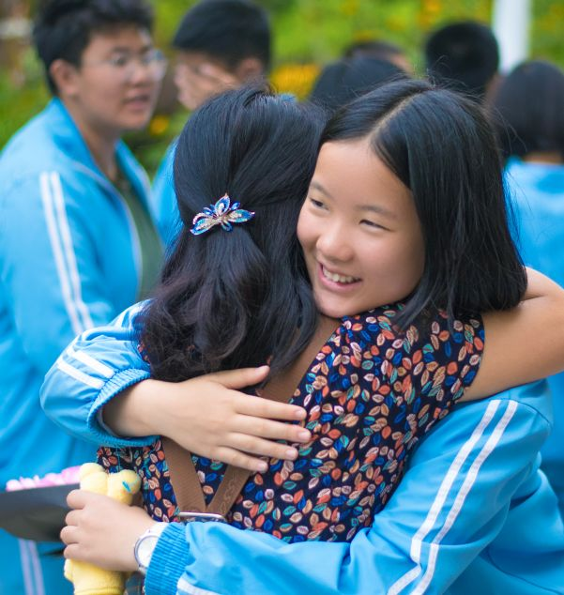
say thanks to teachers
say goodbye to classmates

Slide 7


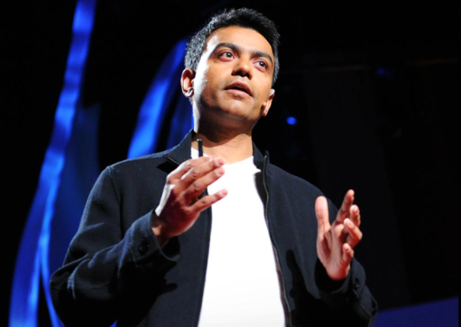
If you have a chance to give a speech at the graduation ceremony, what will you say?
Read the passage and get more information.
Notes:
7
教师可根据自身教学风格和学生特点任选一个导入

Slide 8


Read the passage and answer the questions.
2b

Slide 9
1. What kind of text is this? Is it a story, a
speech or a notice?
It is a speech.
2. Who do you think wrote it?
The principal of the school is probably the person who wrote it.
3. Who is it for?
It is for the graduating students of the school.

Slide 10
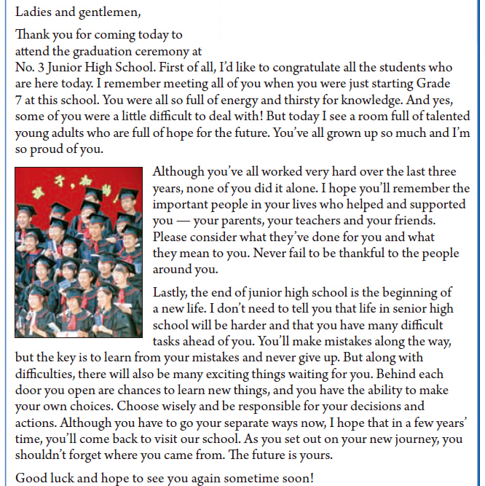
称呼语
For reference
问候语
演讲稿
最常用的是 Ladies and gentlemen，也可根据不同情况，选用Fellow students, Distinguished guests等等
具体的演讲内容
结尾

Slide 11
Read the passage and match the main idea for each paragraph.
Tell students something they should or shouldn’t do in the future.
Tell students to be thankful to those who have helped them.
Congratulate all the students and compare the past with the present.
Para. 1
Para. 2
Para. 3
v.祝贺

Slide 12

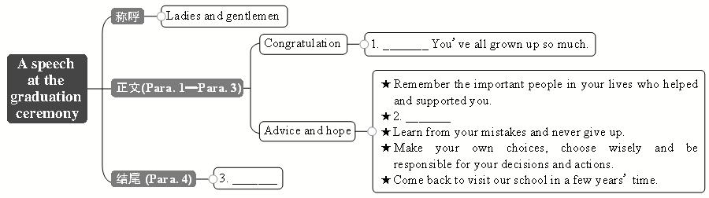
Complete the sentences.
C
A
B
A. Be thankful to the people around you.
B. Good luck and hope to see you again sometime soon!
C. You’re talented young adults who are full of hope for
the future.

Slide 13
Read the passage again and answer the questions.
2c
adj.渴望的；口渴的
1. What were the students like in Grade7?
2. How have the students changed?
They were all so full of energy and thirsty for knowledge.
They have become talented young adults who are full of hope for the future.

Slide 14
3. Who should the students thank and why?
4. What will senior high be like?
They should thank the important people in their lives – their parents, teachers and friends – because these are the people who have helped and supported them.
Life in senior high will be harder and the students will have many difficult tasks ahead of them.

Slide 15
5. How should the students deal with
the future?
6. What advice would you give to students who
are just starting junior high school?
They should learn from their mistakes and never give up, choose wisely and be responsible for their own decisions and actions, and not forget where they came from.
Open.

Slide 16
Fill in the blanks with the correct forms of the words in the box.
2d
attend be thirsty for none
set out be proud of
1. It is time to say goodbye, but _____ of us want to leave.
none

Slide 17
attend be thirsty for none
set out be proud of
2. It is always hard to separate from those
whom you have spent so much time
with for the past three years. However, we are still excited to ______ on a new journey when we enter senior high school.
3. The teacher can see in our eyes that we
_____________ knowledge. She tells us that knowledge will give us wings to fly.
adj.单独的；分离的 v. 分开；分离
set out
are thirsty for
n.翅膀；翼

Slide 18
attend be thirsty for none
set out be proud of
4. We will ________ the junior high
graduation ceremony tomorrow. It is a
very special time for us.
5. Our teachers and parents will
__________ us because we have grown
up and can be responsible for ourselves.
attend
be proud of

Slide 19

2e
Underline the sentences you like in the passage. Tell your partner what they mean and why you like them.

Slide 20


毕业典礼
首先
渴求知识
成长
在过去的三年里
对某人心存感激
新生活的开始
出发; 启程
graduation ceremony
first of all
be thirsty for knowledge
grow up
over the last three years
be thankful to sb.
the beginning of a new life
set out

Slide 21
处理, 对付
在……前面
连同；除……以外还
做出你自己的选择
(三个或以上)都不 / 没有一个
分离；隔开
为……骄傲；感到自豪
对......有责任; 负责任
deal with
ahead of…
along with
make your own decision
none of…
separate from…
be proud of…
be responsible for

Slide 22


Ⅰ. 根据句意及所给汉语提示，写出句中所
缺单词。
1. Ben, __________ (最后), I would like to
ask about your future plans.
2. Alfred won the speech contest. All his
friends _____________ (祝贺) him.
3. It starts to rain, so we’ll have to hold the
__________ (典礼) indoors this evening.
lastly
congratulated
ceremony

Slide 23
4. Michael has been ill recently. That’s why he
can’t finish the __________ (任务) on time.
5. Though they used to be next-door neighbors,
Tara knows little about this __________(绅士).
6. When college finished, Mario and I went our
__________ (单独的) ways and I never saw
him again.
7. Jeff works in a big company. He went to the
company after __________ (毕业) and has
never changed his job.
task
gentleman
separate
graduation

Slide 24
Ⅱ. 根据语境，从方框中选择恰当的短语填空，
有的需要变换形式，每个短语限用一次。
set out, grow up, first of all, ahead of, along with, be thankful to, be responsible for
be responsible for
1. As teachers, we should _________________
our students.
2. Jenny received a book _________________
a letter yesterday afternoon.
3. Jordan was born in New York and
_________________ in North Carolina.
along with
grew up

Slide 25
set out, grow up, first of all, ahead of, along with, be thankful to, be responsible for
4. Mr. Green helped Lisa make her dream
come true. She _________________ him.
5.—What time are you planning to
_________________ tomorrow?
—At five o’clock, for we don’t want to
miss the first train.
was thankful to
set out

Slide 26
set out, grow up, first of all, ahead of, along with, be thankful to, be responsible for
6. —How do you feel after living in France for
a year?
—_________________, I feel much more
confident about my French.
7. The tickets for the Sea World are at a 30%
discount (打折) if you buy them online and
at least two weeks _________________ time.
First of all
ahead of

Slide 27


Write about what you have gotten in
junior high school and your plans in
the senior high school.

Slide 28


